Slide 1
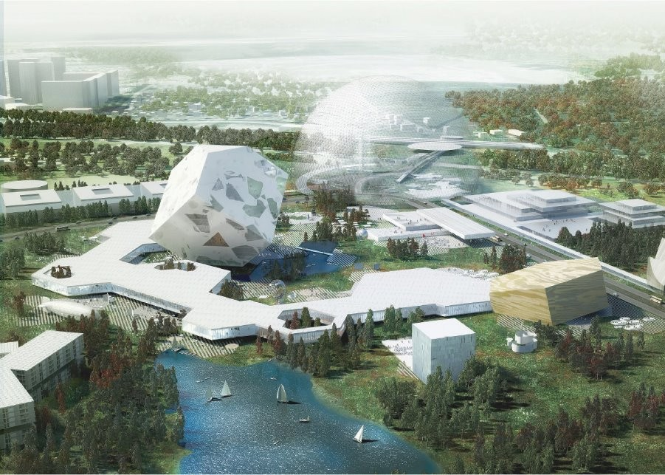
Skolkovo – innovation lives here
Skolkovo Key Partners – Presentation (Long)
Notes:
Вариант-1

Slide 2
Skolkovo Mission
Diversify the Russian economy through innovation and entrepreneurship
Integrate Russian science and technology into the global economy
Develop human capital through world-class research
Nurture competitive knowledge-based companies

Slide 3
Skolkovo Ecosystem
Funding
VC funding
Bank lending
Skolkovo grants
Science
Pan-Russian network
State Companies
Closed cities
SkTech
Partnership with MIT
1,200 grad students
500 professors and PhD’s
Human Capital
Talented/educated labor force
Relatively low salaries
Expatriate network
R&D
R&D centers of the major companies
Start-up pipeline
Incentives
Tax benefits
Co-financing with Skolkovo
Government support

Slide 4
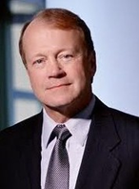
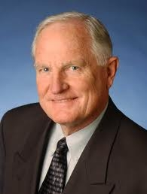
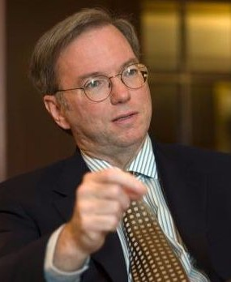
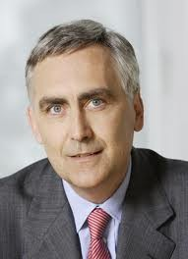
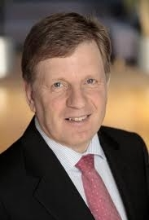
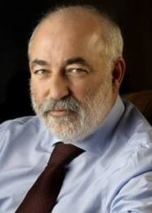
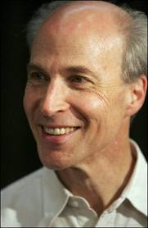
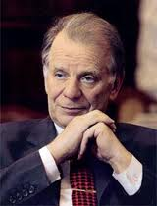
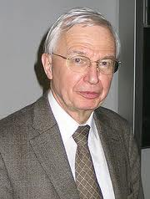
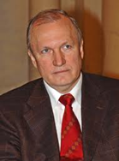
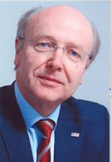
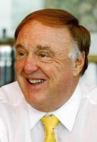
Skolkovo People
Skolkovo Foundation Council - highest decision making body of the Skolkovo Foundation. Its members include:
John T. Chambers Chairman and CEO of Cisco. | Craig Barrett Former CEO of Intel | Eric E. Schmidt Chairman and CEO of Google | Peter Löscher CEO of Siemens AG | Esko Aho Former PM of Finland | Victor Vekselberg President of Foundation
Scientific Advisory Council - sets priorities for R&D at Skolkovo. Its members include:
Roger David Kornberg, Nobel Prize laureate | Zhores Alferov Nobel Prize laureate | Jean-Mari Lehn, Nobel Prize laureate | Valery Kozlov VP, Russian Academy of Sciences | Siegfried Dais Vice-Chairman, Bosch GmbH | Richard Lerner President, Scripps Research Institute

Slide 5
Skolkovo Focus:
Skolkovo focuses on five broad industries and builds synergies between them
Energy Efficiency &
Cleantech
Hardware,
Software
& Distributed Computation
Pharmaceuticals,
Biotechnology,
Medical Devices
&
BioIT
Space Technologies, Tele-Communications
&
Navigation Systems
(Undisputed global leader)
Nuclear & Radiation Technologies, Materials
&
Engineering
Energy
IT
Biomedical
Space
Nuclear

Slide 6
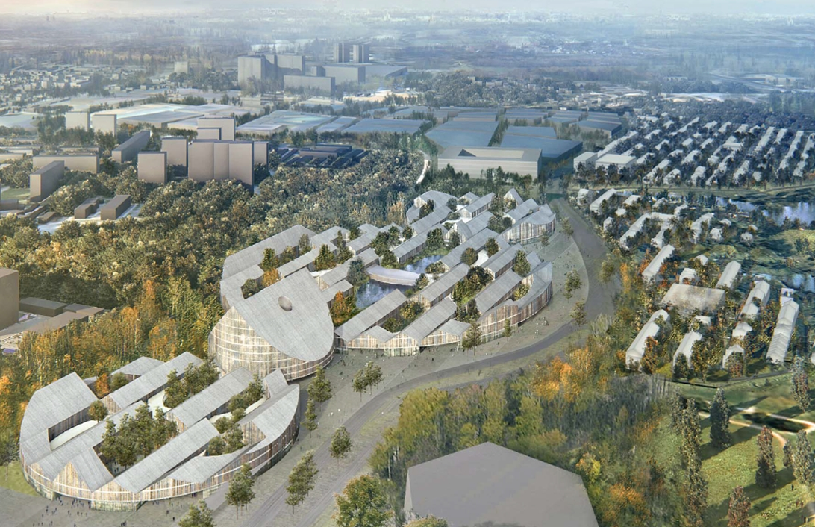
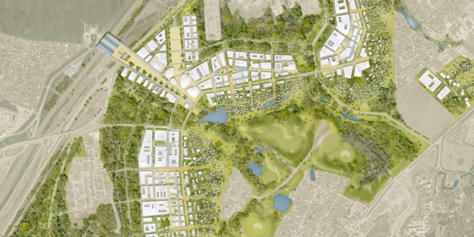
Infrastructure:
South-West Outskirts of Moscow, 19 km. from downtown Moscow
Skolkovo will provide great conditions for 31,000 people to live and work comfortably
Half the population foreign nationals, outstanding scientists, professionals, students
Nearly tax free economic zone (no profit tax, no VAT, etc.)
Innovative architectural, engineering, energy efficiency solutions
Unmatched infrastructure, human capital and corporate environment for technological innovation

Slide 7
Skolkovo Institute of Science and Technology (SkTech)
Education
Start-ups
Corporations & Venture capital
Research
Graduate university that fully integrates research, education, innovation and entrepreneurship
In partnership with MIT
5 focus areas in line with 5 Skolkovo focus areas
15 research centers (with 3-4 labs each)
1200 graduate students and 300 postdocs
Outstanding faculty, researchers and industrial partners from around the world
Skolkovo Model

Slide 8
Skolkovo Key Partners:
International Companies:
Russian Companies :

Slide 9
Examples of R&D Activities:
EADS Russian Technology Office at Skolkovo:
about 400 sq. m.
15 employees
IBM Research Center at Skolkovo:
about 2 000 sq. m.
150 employees
Nokia Research Center at Skolkovo:
about 500 sq. m.
25 employees
Siemens Research Center at Skolkovo:
about 4 000 sq. m.
150 employees
R&D plan:
Project 1 – IT Security
Project 2 – Complex engineering solutions
Project 3 – "Green" Energy
Project 4 – Energy storage
R&D plan:
Energy & Utility:
Project 1 – Energy storage
Project 2 – Analytical software
Biomedical:
Project 3 – Computer aided drug design
IT:
Project 4 – Software for the
financial and banking sectors
Project 5 – IT in medicine and health care
Nokia Ventures co-operation with Skolkovo
R&D plan:
Project 1 – Flexible electronics research project
Project 2 – Wireless sensor networks
R&D plan:
Project 1 – VHF-systems
Project 2 – Analytical software
Project 3 – New energy generation
Project 4 – Personalized medicine

Slide 10
Industrial Advisory Board (IAB)
Skolkovo Industrial Advisory Board (IAB) is a feedback mechanism for major companies
IAB actively promotes company access to government and policymakers
IAB gives companies a channel to communicate their industry-wide issues
Companies are represented on IAB by heads of country level
IAB meets 3 times a year (Spring, Summer, Autumn)
IAB
Skolkovo President
Presidential Administration
Legislative initiatives
Commission on Modernization
Company feedback
Foundation Council
City Planning Board
Market access issues
Scientific Advisory Board

Slide 11
Skolkovo Participant Benefits:
Skolkovo benefits for participant companies and start-ups:
Incubator Housing
Mentoring
Non-Diluting Grants
No VAT & Income tax
Insurance premiums
Accounting and Legal services
Shared-use CAPEX
No Customs Duty
Visas
for Foreigners
Venture Capital

Slide 12
What Skolkovo is, what Skolkovo is not
What we are
We provide financial grants,
we are not-for-profit
We finance and support R&D and
early-stage companies
We are a platform for international collaboration in R&D and technology transfer
We support and finance innovative
R&D and technology start-ups
What we are not
We are not an investment fund; we do not invest, take equity stakes or board seats
We do not finance production or advanced commercial operations We are not a sales agent
We are not limited to only Russian technology; in fact our mandate is to enhance 2-way tech transfer

Slide 13
Opportunities for Key Partners
Why Come to Skolkovo:
Create and operate an R&D center in Skolkovo employing a wealth of local scientific expertise, take advantage of the great opportunities for research and development
Collaborate on research with SkTech, leading Russian scientific institutions and start-ups
Closely evaluate Skolkovo’s pipeline of promising technologies; co-invest in promising Skolkovo start-ups
Receive access to Russian government and policymakers (legislative initiatives/GR)
Receive research and development grants from Skolkovo
Receive substantial tax benefits.
De-risk your investment into Russia with enhanced IPR protection, reduced bureaucratic burden, etc.
Participate in building Skolkovo infrastructure

Slide 14
Conor Lenihan
Vice-President for International Partnerships
Skolkovo Foundation
12 Krasnopresnenskaya emb.,
Moscow, 123610
tel: +7 495 967 0148 ext. 2182
fax: +7 495 967 0196
e-mail: CLenihan@sk.ru
web: www.sk.ru
Roman Romanovsky
Operating Director for
Key Partners
12 Krasnopresnenskaya emb.,
Moscow, 123610
Tel: +7 (495) 96701 48 ext. 3001
Mobile: +7 917 5662911
Email: RRomanovsky@sk.ru

