Slide 1
Role of Public Research Institutes
Chintay Shih
Chairman, III
Chair Professor
National Tsing Hua University, Taiwan

Slide 2
Taiwan Profile
Area: 36,188KM²
highest point is Yu Shan (Jade Mountain) at 3,952 meters, making the world's 4th highest island.
Population:
Total: 23 million (50th)
Density: 641/km2 (17th)
78% resided in metropolitan areas
GDP (nominal, 2011 est.)
Total: 504.612 billion(24th)
Per capita: 21,591.770(37th)
Growth rate (’08-’10): -2.25%, -1.10%, 9.08%
Labor Force: 11.2 million (2011 ave.)
Male:56.3%, Female: 43.7%
Unemployment: 4.38%
Notes:
Despite Taiwan’s relatively small land area, its ICT industry and key components sectors have accomplished amazing feats.
Taiwan is the one-stop shop for the world’s ICT product needs.

Slide 3
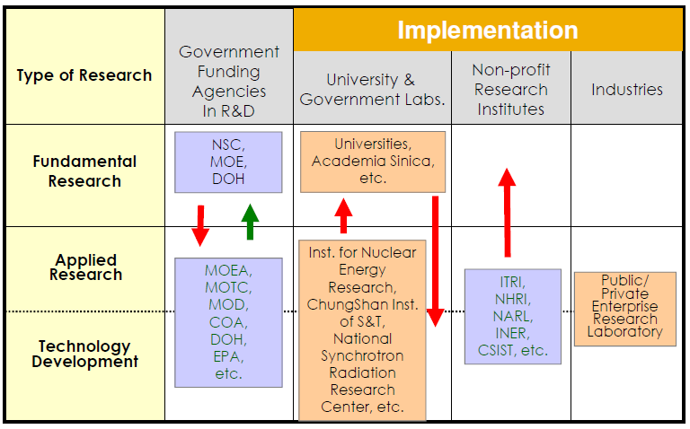
Technology Development in Taiwan
Source: Science and Technology Yearbook, 2008

Slide 4
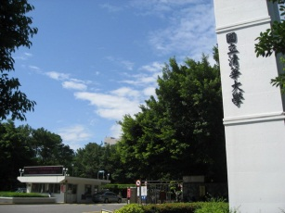
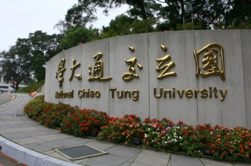
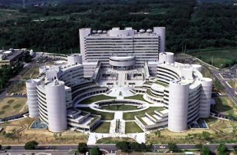
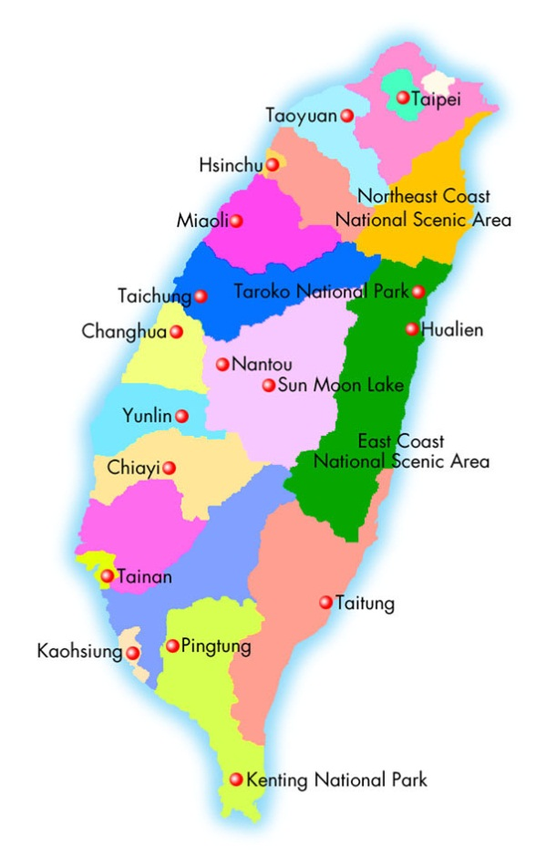
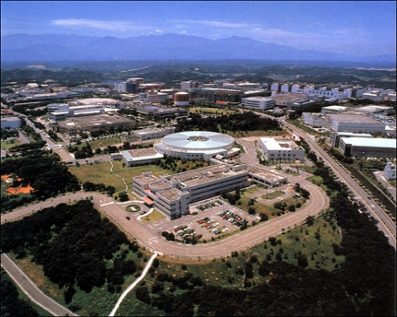
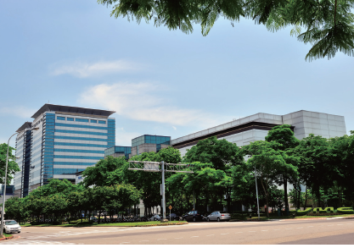
HsinChu Science Based Industrial Park (HSIP)
NTHU
NCTU
ITRI
ITRI
HSIP
6 National Lab
632 ha.

Slide 5
Major Research Institutions in Taiwan
Industrial Technology Research Institute (ITRI)
Institute for Information Industry (III)
Development Center for Biotechnology (DCB)
Metal Industries Research and Development Center (MIRDC)
Food Industry Research and Development Institute (FIRDI)
Taiwan Textile Research Institute (TTRI)
Automobile Research and Testing Center (ARTC)
National Health Research Institute (NHRI)
…….
…….

Slide 6
Role of ITRI
As “bridge” and “partner” for Taiwanese companies
Lead in National R&D projects
Facilitate technological diffusion & spin-off
Talent flow, Encouraging entrepreneurship
Technology disseminating & Sharing
Transfer in foreign technology
Spin-off company
Incubator
Open Lab for technology R&D collaboration

Slide 7
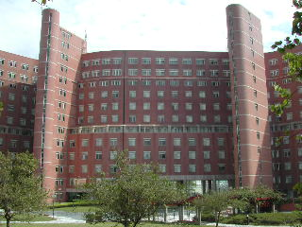
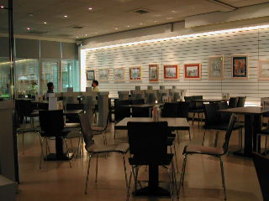
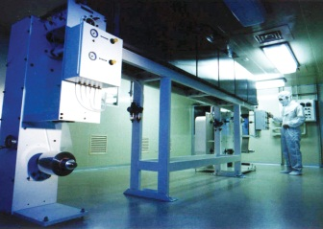
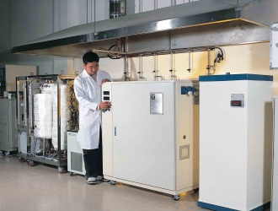
ITRI’s Profile
Mission and strategy:
Lead industrial upgrade, establish new industry, cultivate talents, and promote international competitiveness by means of technological innovation
Vision: World Class Research Institute, and Pioneer for the Industry
Value code: Innovation, Integrity, Sharing
Overview:
Turnover: 611 million USD in 2010, 50% from Tech. Project, 41% from Contract Service and 9% from Tech. Transfer
14,571 patents to date
Facilitate 163 start-ups and spin-offs

Slide 8
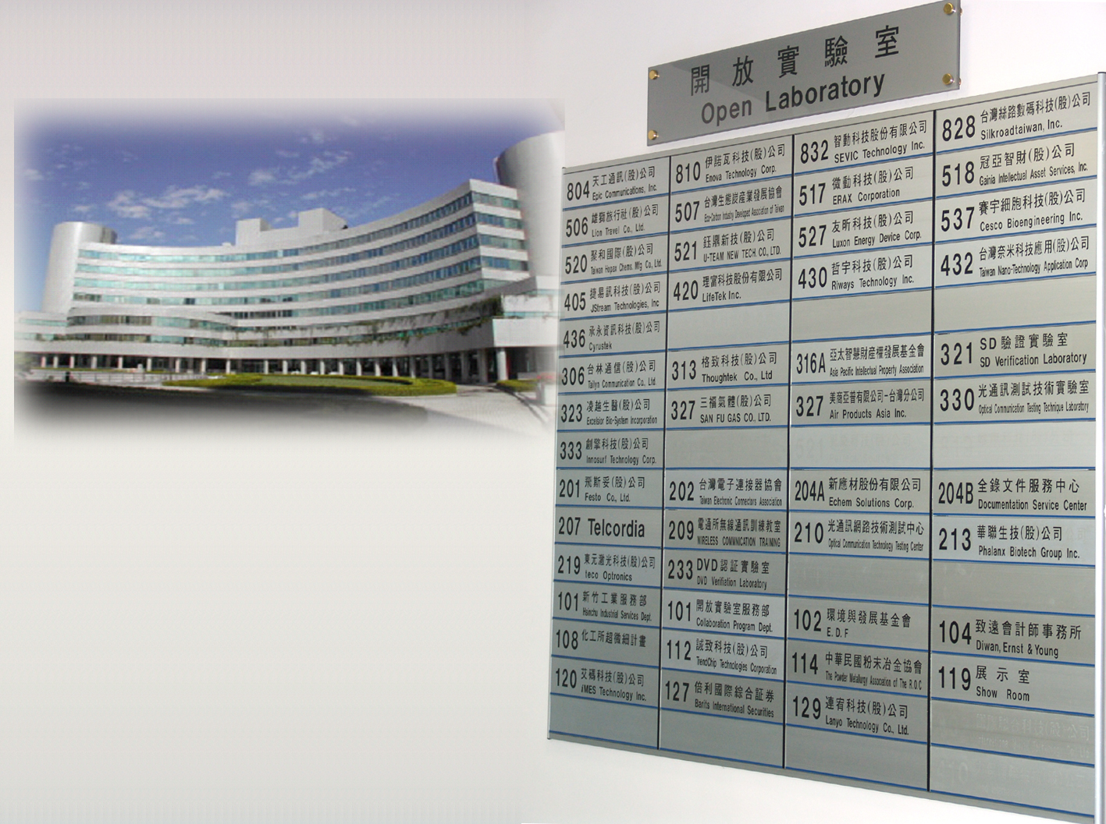
ITRI Open Lab and Incubation
231 Cooperation Projects, 141 firms incubated , total investment capital NT$ 47.2 billion, and 37 firms set up in Science Park
Overseas Incubation Project in Silicon Valley to promote entrepreneurs and technology
Annual Award in 2006 by NBIA
Notes:
1.首先141家不含Spin-off48家(據技轉說法統計至今) 2.141家主要分兩部分,105家育成進駐企業,OPEN LAB裡為1年半內之新創事業約36家 (僅統計近十年來) 3.所以整體來說,工研院所創造協助之新創公司應該>141 但<189(因為有些Spin-off 公司有進育成所以會重複算)

Slide 9
ITRI and HSP – Where Taiwan’s High-Tech began

Slide 10
Institute for Information Industry (III)
Established in 1979
R&D in Information technology and promote information society
Provide technology & services for e-government
Training information professional
Market intelligent & legal services
Development of software & service industry
Creating innovation & new start-ups

Slide 11
E-government Promoted by III
Offer 3,984 online services for gov’t efficiency
64.7% tax payers filed Income Tax online
97.8% business entities pay Sales Tax online
Implement GPKI and information security service to ensure a secure environm’t for gov’t transactions
Rank top 5 from 2001~2008(Top 1 for 3 yrs) in Global e-Gov’t Study by Brown University

Slide 12
Institution of Venture Capital in Taiwan
Initiate
“Regulations Governing Venture Capital Investment Enterprises” promulgated by Executive Yuan in 1983
First Syndicated VC Fund Formed in 1984
Government founded “fund of funds” to join H&Q in 1986
Results : (end of 2010)
293 venture funds (181 Operating Funds), and the capital amount almost NT$ 264 Billion
Investment in more than 13,000 technology companies, and support 400+ start-ups to IPO
Source : Taiwan Venture Capital Association

Slide 13
13
Notes:
現在各位所看到的這張空照圖是園區將近30年前剛開發時的情況，剛興建完成的管理局位於園區中央，下方是園區大門口及HTI大門的意象，代表的是 High Technology Industry，高科技產業的意思。在照片的右下方是園區的污水處理廠，左方則是園區住宅區；園區大門口外，也就是照片下方是供應園區所需的電力的變電站。

Slide 14
14
Notes:
相較於30年前的照片，現在園區的開發已經接近飽和。從這張空照圖看來，上方藍色部分為台灣海峽，與中國大陸福建彼此相對；右上方為新竹市區，中間這區域就是新竹科學園區所在的位置。中山高速公路橫越園區，往右可直達台北與桃園國際機場，往左則可通往台中港，車程各約一小時，所以新竹科學園區的交通可以說是相當的便利。
目前園區內已興建完成的住宅區，可提供大約1,700戶給大約3,000名員工及其家眷住宿。此外，園區旁還有交通大學及清華大學兩所以理工背景為主的國立大學，各自有一萬多名的學生。園區附近還有工研院，院內約有六千多名的優秀研究人員。

Slide 15
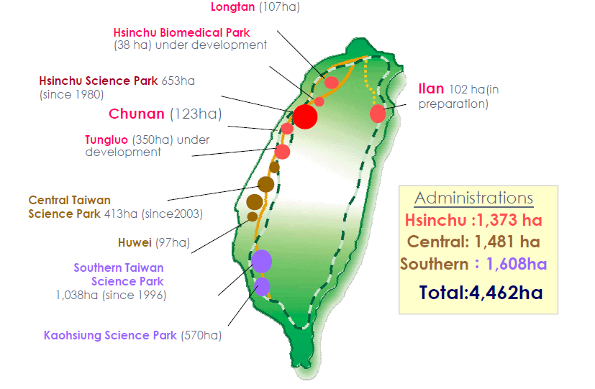
Science Parks Development in Taiwan

Slide 16
HSIP stages of development
%
100.00
90.00
PC-
IC-
innovation
資料來源：新竹科學園區

Slide 17
High-tech development
& Human Resources
HSIP as example
source: ITRI

Slide 18
Univ-Gov-Industry-PRO in Taiwan
Co-creating new value and synergy
Industry
Innovation Capacity
Government
Environment for Innovation
Value Creation
Univ
Research Institute
Linkage of social needs
Service Oriented
ITRI lab@-X-University

