Slide 1
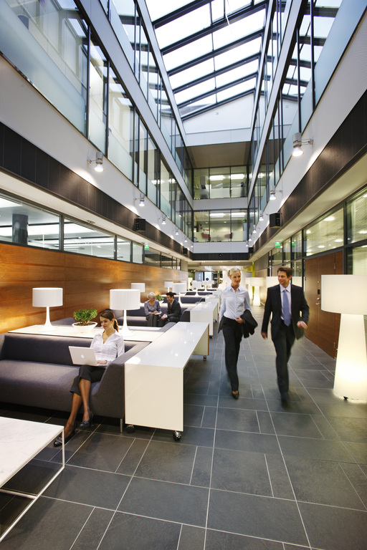
GLOBAL SUMMIT OF INNOVATION ECONOMY CREATORS MOSCOW 17.-20.4.2012 CASE TECHNOPOLIS MR. PERTTI HUUSKONEN CEO, LUNacon ltd FORMER CEO & CHAIRMAN OF TECHNOPOLI S PLC

Slide 2
IN SUPPORT OF YOUR SUCCESS
TECHNOPOLIS PLC
Technopolis offers modern business environments where companies can focus on their own core competence
Growth-oriented, internationalizing, profitable Nasdaq OMX company
The business idea is to offer premises and services that support the success of high tech companies
The customers include approximately 1,300 knowledge-intensive companies and organizations with over 20,000 employees
Established over 30 years ago

Slide 3
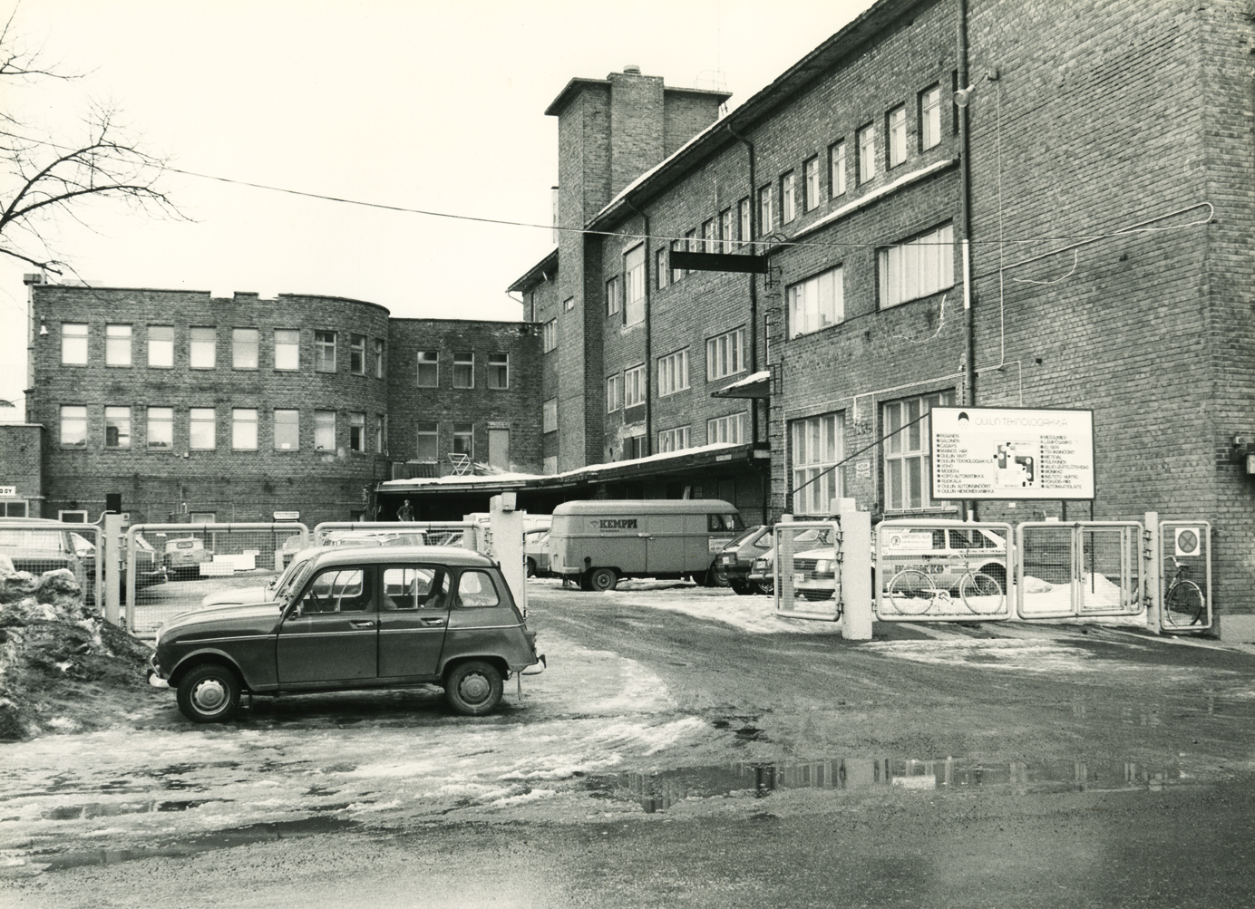
Notes:
Oulun Teknologiakylä Oy maaliskuussa 1982
Pohjoismaiden ensimmäinen teknologiakylä
Ens. puitteet 4000 m2 entisistä meijerin tiloista
Vaatimattomat ja kustannustehokkaat vuokratilat
Vihkiäisissä 24 yritystä ja näissä 140 työntekijää

Slide 4
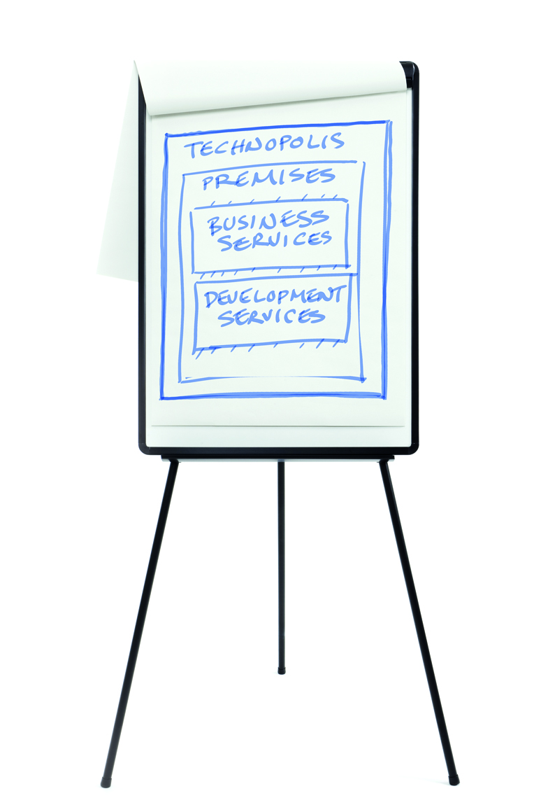
FOR THE BEST FOR YOUR COMPANY
TECHNOPOLIS CONCEPT
Combines premises, business services and development services into a package that supports success
Supports customers' growth and internationalization
Helps make operations more efficient, trimming costs and reducing environmental loads
Facilitates local and international networks

Slide 5
IN THE BEST LOCATIONS
NETWORK OF CENTERS
Chain of 17 impressive business environments in Espoo, Helsinki, Jyväskylä, Kuopio, Lappeenranta, Oulu, Tampere, and Vantaa, as well as St. Petersburg in Russia and Tallinn in Estonia
Premium premises of 6.5 m² - 40,000 m²
Adaptability ensures that your company always has access to appropriate premises
Combined with the services, the business environments establish a strong ecosystem with all required actors

Slide 6
YOUR NETWORK EFFICIENTLY
MATCHMAKING SERVICES
High-quality matchmaking events
Technopolis Business Breakfast
MoneyTalks® on a monthly basis
MoneyTalks® Forum twice a year
Tailored events
Contacts with the Technopolis network, customers, partners, growth companies and investors
Preferred Partner Program (P3)
International VC Zone
Enterprise Europe Network
Fundraising services

Slide 7
TECHNOPOLIS FACILITY GROWTH 1982-2011

